Slide 1


6th Semester MAD Mini Project ASYNCHRONOUS TASK
PRESENTED BY:
DEEPIKA M L 1DB20IS043
GUIDED BY:
Mr. Abhinand B V
Assistant Professor
Department of ISE
DBIT
Department of Information Science and Engineering
Don Bosco Institute of Technology, Mysore road, Kumbalagodu, Bangalore

Slide 2
AGENDA
INTRODUCTION
ABSTRACT
PROBLEM STATEMENT AND OBJECTIVES
SYSTEM REQUIREMENT
STEPS FOE EXECUTION
SNAPSHOTS
CONCLUSION
REFERENCE

Slide 3
INTRODUCTION
In recent years, the emergence of smart phones has changed the definition of mobile phones. Phone is no longer just a communication tool, but also an essential part of the people's communication and daily life. Various applications added unlimited fun for people's lives.
It is certain that the future of the network will be the mobile terminal. Now the Android system in the electronics market is becoming more and more popular, especially in the smartphone market. Because of the open source, some of the development tools are free, so there are plenty of applications generated. This greatly inspired the people to use the Android system.

Slide 4
ABSTRACT
The main aim and objective of this project were to demonstrate the use of Asynchronous task in android asynchronous task is designed to be a helper class around thread and handler and does not constitute a generic threading framework. Asynchronous Tasks are to ideally be used for short operations (a few seconds at the most.). An asynchronous task is defined by a computation that runs on a background thread and whose result is published on the UI thread, Implement the use of asynchronous task by implementing the functionality of a simple moving banner using a set of start and stop buttons , and we also improvise by adding additional features like adapting to a slideshow of pictures by fading in and out for the background using view flipper class text to speech which can be used to speak out the words from the banner in an advertise manner and toast messages indicating the current status of the banner.

Slide 5
PROBLEM STATEMENT AND OBJECTIVES
PROBLEM STATEMENT
Develop an application to demonstrate the use of Asynchronous tasks in android. The asynchronous task should implement the functionality of a simple moving banner. On pressing the Start Task button, the banner message should scroll from right to left. On pressing the Stop Task button, the banner message should stop. Let the banner message be “Demonstration of Asynchronous Task with improvised background slide show.

Slide 6
OBJECTIVES
To design an xml code that can display a moving banner of messages using the asynchronous task class.
To code a java program that can display a moving banner of messages using the asynchronous task class on press of a button.
Adding additional features to improve system and user interface by fading in and out of a changing background slide show.
Testing the code for all its intended functionalities by an android device or avd.

Slide 7
SYSTEM REQUIREMENT
HARDWARE REQUIREMENT
Minimum RAM : 8 GB or more.
Processor : Intel core i5 9th Gen.
Disk Space : 20 GB of available disk space.
Display : 1280 x 800 minimum screen resolution.
SOFTWARE REQUIREMENT
Operating System : 64-bit Microsoft Windows 8/10.
Emulator : Pixel 4 api 30.
Target SDK version : 30.
Language Used : xml , java.
JDK version : java development kit 16.

Slide 8
STEPS FOR EXECUTION
Run the Android Studio on laptop or desktop.
Create a project and enter the source codes of xml and java.
In Android Studio, create an Android Virtual Device (AVD) that the emulator can use to install and run your app.
In the toolbar, select your app from the run/debug configurations drop-down menu.
From the target device drop-down menu, select the AVD that you want to run your app on.
Click Run. Android Studio installs the app on the AVD and starts the emulator.

Slide 9
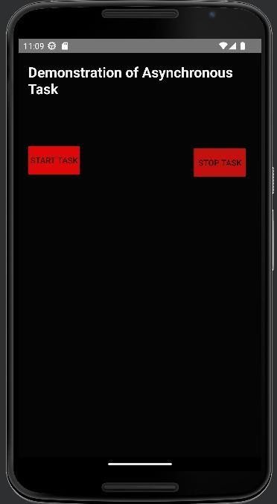
SNAPSHOT
MAIN PAGE:
Figure 1: Main Page
The Figure 1 consists of the main page of the android application of asynchronous task.

Slide 10
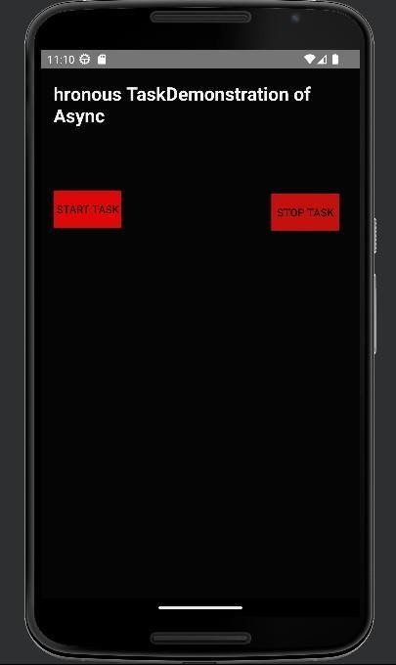
START OPERATION:
Figure 2: Start Operation
In the Figure 2 on clicking the start button the text starts to move right to left.

Slide 11
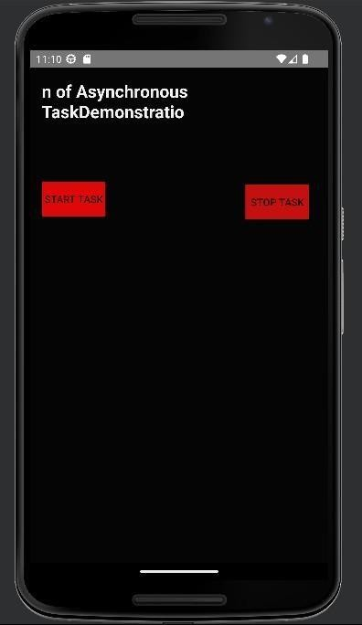
STOP OPERATION:
Figure 3: Stop Operation
In the Figure 3 on clicking the stop button the text stops to move.

Slide 12
CONCLUSION
Android as a full, open, and free mobile device platform, with its powerful function and good user experience rapidly developed into the most popular mobile operating system. This report gives an overview of the different challenges and issues faced in android app development The experience of developing an android app is quite challenging, motivating as well as satisfying.
While implementing this project we came across two highly useful android studio classes and methods which are 1) asynchronous task which communicates with background threads and facilitates the background processing of task, and also to improvise the mini project we had to improvise on the background slide show which introduced us to the view flipper class which helps us in changing the background with fade-in and fade-out animations.

Slide 13
REFERENCES
Website:
[1]. YouTube : https://www.youtube.com/
[2]. https://developer.android.com/studio
[3].https://www.gitbook.com/book/google-developer-training/android-developer-
[5].fundamentals-course- concepts/details
[6].https://developer.android.com/reference/android/os/AsyncTask
Reference Book:
Google Developer Training, "Android Developer Fundamentals Course – Concept Reference,” Google Developer Training Team, 2017.

Slide 14


